Slide 1


Crownpeak DQM Plug-in
Installation Guide: AEMaacs
July 2022

Slide 2

Requirements
AEMaacs environment
✓
✓
✓
✓
✓
Admin access on your AEM instance
Crownpeak API Key
Crownpeak configured Website ID
You may also need to whitelist our API endpoints:
  api.crownpeak.net
  ✓ api.digitalqualitymanager.com

Slide 3
1 Install the New Plug-in

Slide 4
Installation overview
The installation of additional packages in Adobe Experience Manager as a cloud service, has been limited to be performed only through the official project build workflow on Cloud Manager – that is Adobe's CI/CD tool.
Thus to install an additional package one needs to alter the application configuration within the application codebase.
This is best done by a developer, but someone with a bit broader computer experience should also be able to handle that task.
*You should have received a link to download the latest .zip package from a member of the Crownpeak team, along with a new API key and Website ID.

Slide 5

Installation
Copy crownpeak plugin to application codebase
Configure a maven-local repo
Include crownpeak plugin in the build
Create OSGi configuration

Slide 6

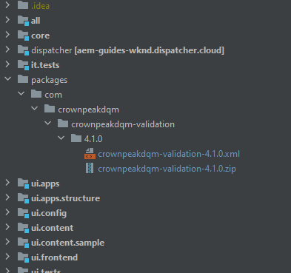
1.1 Copy crownpeak plugin to codebase
Navigate to your codebase root and create a directory structure
/packages/com/crownpeakdqm/crownpeakdqm-validation/4.1.0
Place the crownpeak plugin files within the created directory
*You should have received a link to download the latest .zip package from a member of the Crownpeak team, along with a new API key and Website ID.

Slide 7
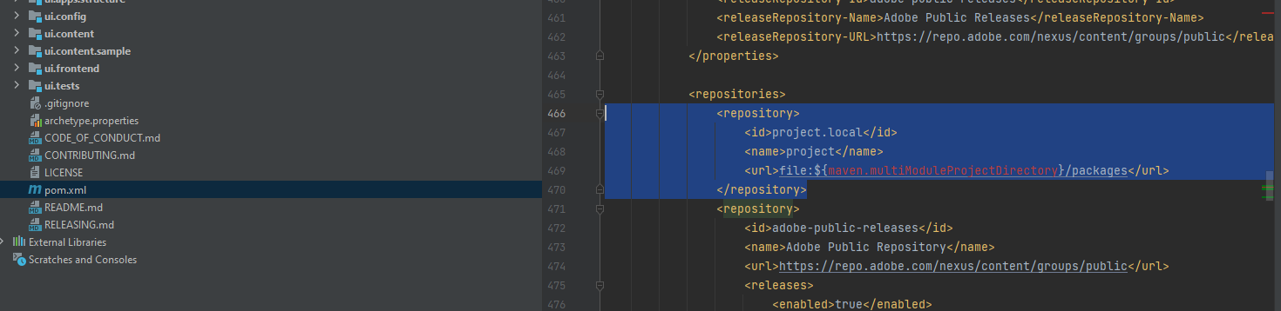
1.2 Create a maven-local repo
Edit the pom.xml file in your root directory
Add a new local "file" repository by adding the following lines within the <repositories> section:
<repository>
<id>project.local</id>
<name>project</name>
<url>file:${maven.multiModuleProjectDirectory}/packages</url>
</repository>

Slide 8
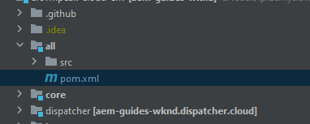
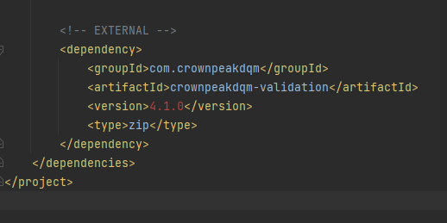
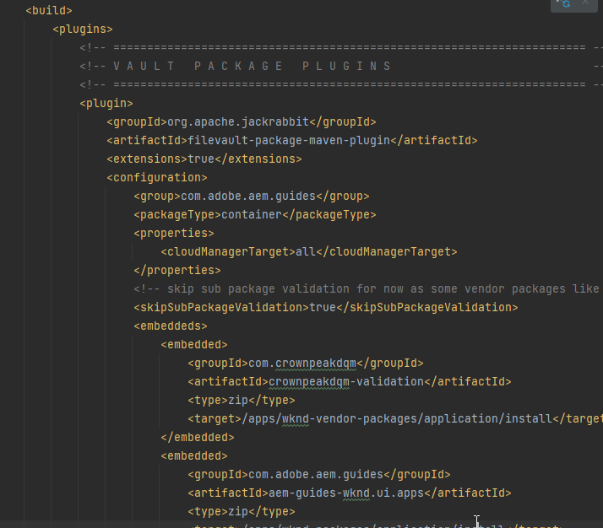
1.3 Include crownpeak plugin in build
Edit the pom.xml file in the 'all' module
Add the following dependency to the <project><dependencies> section
Add the following embedded to the filevault-package-maven-plugin's <configuration><embeddeds> section
<dependency>
<groupId>com.crownpeakdqm</groupId>
<artifactId>crownpeakdqm-validation</artifactId>
<version>4.1.0</version>
<type>zip</type>
</dependency>
<embedded>
<groupId>com.crownpeakdqm</groupId>
<artifactId>crownpeakdqm-validation</artifactId>
<type>zip</type>
<target>/apps/wknd-vendor-packages/application/install</target>
</embedded>

Slide 9
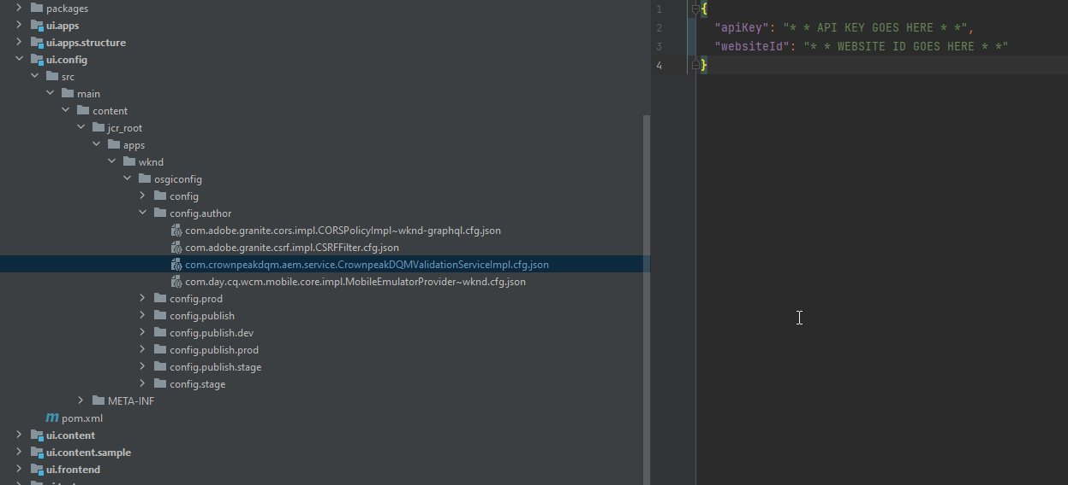
1.4 Create OSGi configuration
Create an author only config for CrownpeakDQM and provide it with apiKey and websiteID
Create config file within your `ui.config` module, place it under osgiconfig/config.author and name it: com.crownpeakdqm.aem.service.CrownpeakDQMValidationServiceImpl.cfg.json
Paste the content snippet from below within the created file and replace the apiKey and websiteId values with ones provided by Crownpeak team
{
"apiKey": "* * API KEY GOES HERE * *",
"websiteId": "* * WEBSITE ID GOES HERE * *"
}

Slide 10
2 Using the DQM Plug-in

Slide 11

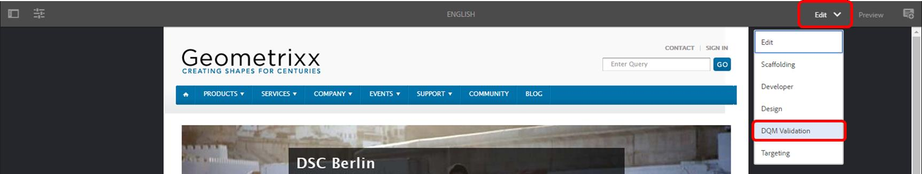
2.1 Enable the Plug-in
Open a page in Edit mode within AEM.
Click the Edit drop-down menu on the right hand side.
Click DQM Validation:

Slide 12


2.2 Run DQM Validation
Once DQM Validation is enabled, a menu will appear on the left hand side, which lists the issues on the page.

Slide 13

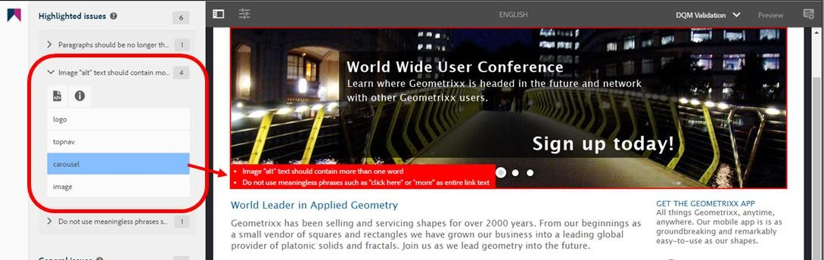

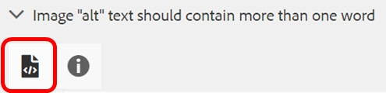

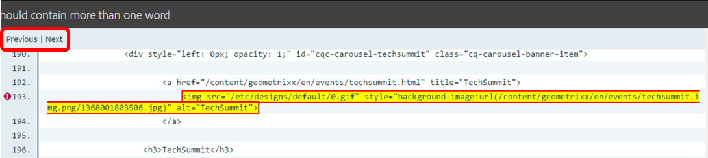
2.3 Issue Highlighting
Page View
Clicking on a particular issue will display where it is highlighted on the page.
Source View
Clicking the Source View icon on an issue will also display it in the page source code.
If there is more than one occurrence of the issue, you can scroll through each one by clicking Previous or Next.

Slide 14

Thank You
If you experience any problems, or have any questions regarding the DQM Plug-in please contact Crownpeak Support using the details below.
Crownpeak DQM Support
dqmhelp@crownpeak.com | support.crownpeak.com

